Slide 1
Notes:
Topics:
Dictionaries
Sets
Serializing Objects

Slide 2
Dictionaries
Dictionary: object that stores a collection of data
Each element consists of a key and a value
Often referred to as mapping of key to value
Key must be an immutable object
To retrieve a specific value, use the key associated with it
Format for creating a dictionary
dictionary = {key1:val1, key2:val2}
Notes:
The values in a dictionary can be objects of any type, but the keys must be immutable objects. For example, keys can be strings, integers, floating-point values, or tuples. Keys cannot be lists or any other type of immutable object.

Slide 3
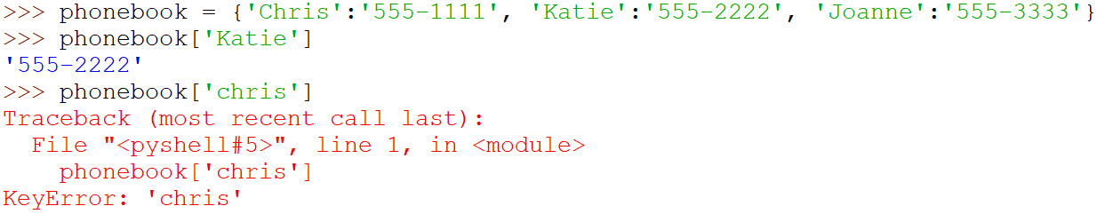
Retrieving a Value from a Dictionary
Elements in dictionary are unsorted
General format for retrieving value from dictionary: dictionary[key]
If key in the dictionary, associated value is returned, otherwise, KeyError exception is raised
Notes:
Dictionaries are not sequences, like lists, tuples, and strings. As a result, you cannot use a numeric index to retrieve a value by its position from a dictionary. Instead, you use a key to retrieve a value. The key is case sensitive.

Slide 4
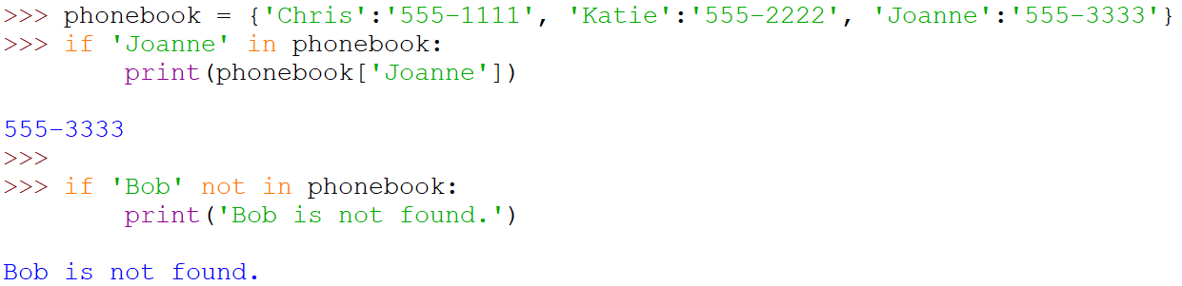
Retrieving a Value from a Dictionary (cont’d.)
Test whether a key is in a dictionary using the in and not in operators
Helps prevent KeyError exceptions

Slide 5
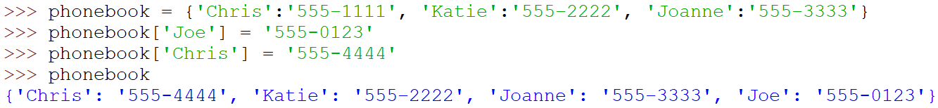
Adding Elements to an Existing Dictionary
Dictionaries are mutable objects
To add a new key-value pair:
dictionary[key] = value
If key exists in the dictionary, the value associated with it will be changed
Notes:
If key already exists in the dictionary, its associated value will be changed to value. If the key does not exist, it will be added to the dictionary, along with value as its associated value.

Slide 6
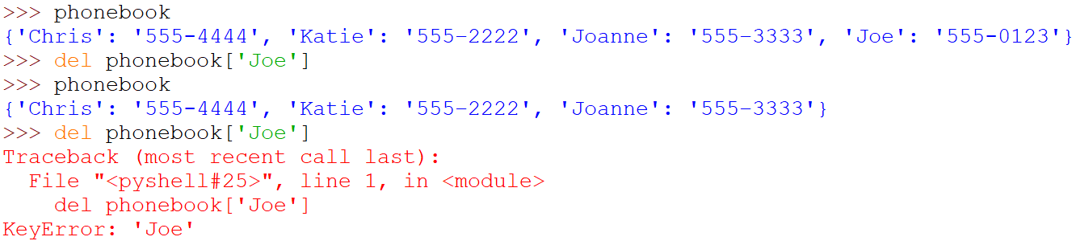
Deleting Elements From an Existing Dictionary
To delete a key-value pair:
del dictionary[key]
If key is not in the dictionary, KeyError exception is raised
Notes:
To prevent a KeyError exception from being raised, you should use the in operator to determine whether a key exists before you try to delete it and its associated value.

Slide 7
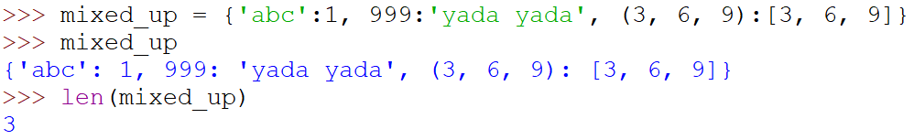
Getting the Number of Elements and Mixing Data Types
len function: used to obtain number of elements in a dictionary
Keys must be immutable objects, but associated values can be any type of object
One dictionary can include keys of several different immutable types
Values stored in a single dictionary can be of different types

Slide 8
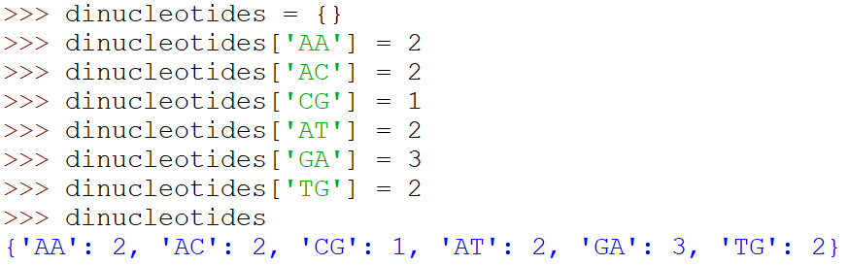
Creating an Empty Dictionary
To create an empty dictionary:
Use {}
Or, use built-in function dict()
Elements can be added to the dictionary as program executes

Slide 9
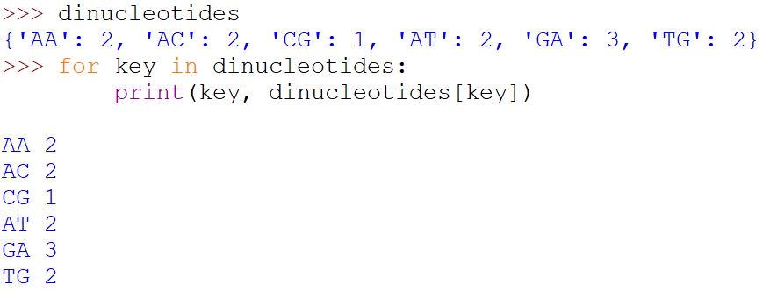
Using for Loop to Iterate Over a Dictionary
Use a for loop to iterate over a dictionary
General format: for key in dictionary:

Slide 10
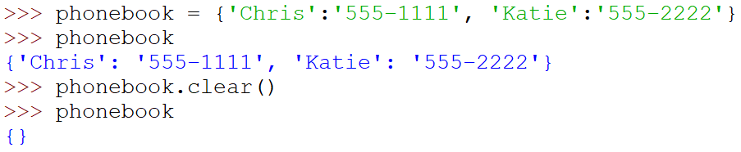
Some Dictionary Methods
clear method: deletes all the elements in a dictionary, leaving it empty
Format: dictionary.clear()

Slide 11
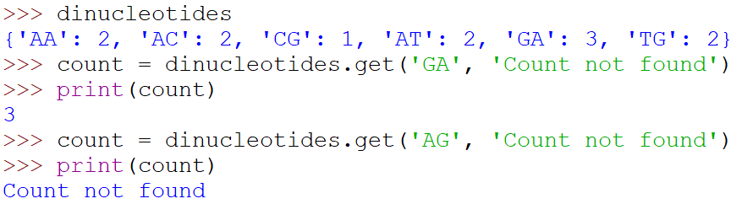
Some Dictionary Methods (cont’d.)
get method: gets a value associated with specified key from the dictionary
Format: dictionary.get(key, default)
default is returned if key is not found
Alternative to [] operator
Cannot raise KeyError exception
Notes:
In the general format, dictionary is the name of a dictionary, key is a key to search for in the dictionary, and default is a default value to return if the key is not found. When the method is called, it returns the value that is associated with the specified key. If the specified key is not found in the dictionary, the method returns default.

Slide 12
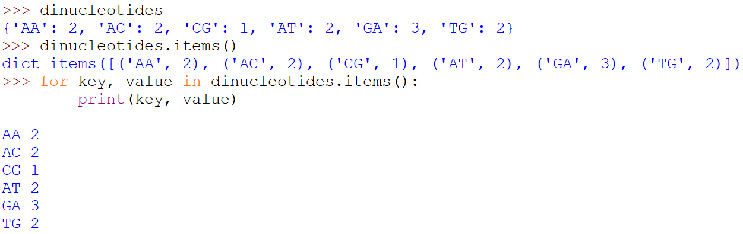
Some Dictionary Methods (cont’d.)
items method: returns all the dictionaries keys and associated values
Format: dictionary.items()
Returned as a dictionary view
Each element in dictionary view is a tuple which contains a key and its associated value
Notes:
When using for loop to iterate over the tuples in the sequence, can use a variable which receives a tuple, or can use two variables which receive key and value.

Slide 13
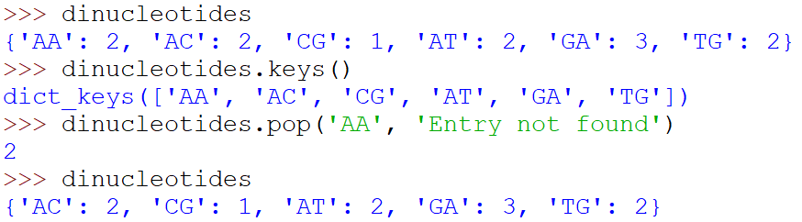
Some Dictionary Methods (cont’d.)
keys method: returns all the dictionaries keys as a sequence
Format: dictionary.keys()
pop method: returns value associated with specified key and removes that key-value pair from the dictionary
Format: dictionary.pop(key, default)
default is returned if key is not found

Slide 14
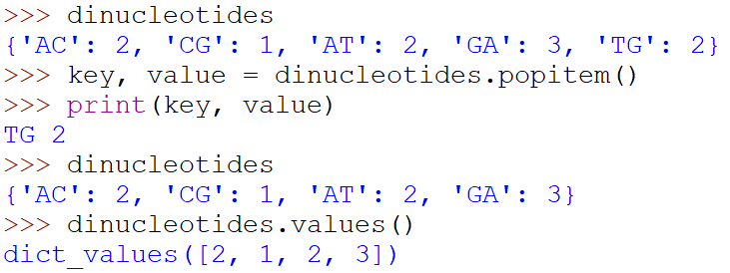
Some Dictionary Methods (cont’d.)
popitem method: returns a randomly selected key-value pair and removes that key-value pair from the dictionary
Format: dictionary.popitem()
Key-value pair returned as a tuple
values method: returns all the dictionaries values as a sequence
Format: dictionary.values()
Use a for loop to iterate over the values

Slide 15
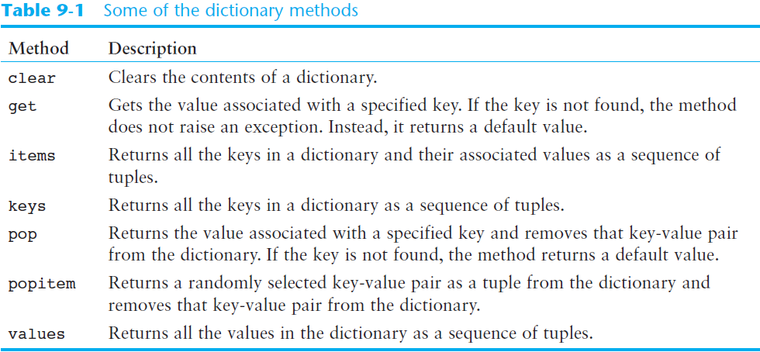
Some Dictionary Methods (cont’d.)

Slide 16


Knowledge Check
1. What is the output?
2. What is the output?
Notes:
bbb
3
1
2
3

Slide 17
Sets
Set: object that stores a collection of data in same way as mathematical set
All items must be unique
Set is unordered
Elements can be of different data types

Slide 18

Creating a Set
set function: used to create a set
For empty set, call set()
For non-empty set, call set(argument) where argument is an object that contains iterable elements
e.g., argument can be a list, string, or tuple
If argument is a string, each character becomes a set element
For set of strings, pass them to the function as a list
If argument contains duplicates, only one of the duplicates will appear in the set
Notes:
# This is an ERROR because you can pass no more than one argument to the set function!
myset = set('one', 'two', 'three’)
# This does not do what we intend.
myset = set('one two three’)
After this statement executes, the myset variable will reference a set containing the elements 'o', 'n', 'e', ' ', 't', 'w', 'h', and 'r’.
# OK, this works.
myset = set(['one', 'two', 'three’])
After this statement executes, the myset variable will reference a set containing the elements 'one', 'two', and 'three'.

Slide 19

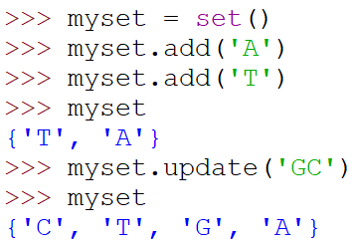
Getting the Number of and Adding Elements
len function: returns the number of elements in the set
Sets are mutable objects
add method: adds an element to a set
update method: adds a group of elements to a set
Notes:
For update method, argument must be a sequence containing iterable elements, and each of the elements is added to the set.

Slide 20
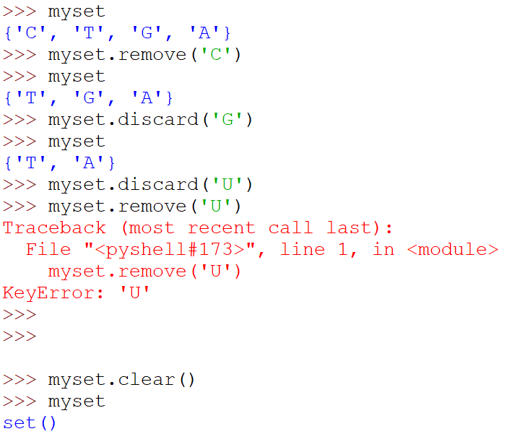
Deleting Elements From a Set
remove and discard methods: remove the specified item from the set
The item that should be removed is passed to both methods as an argument
When the specified item is not found in the set
remove method raises a KeyError exception
discard method does not raise an exception
clear method: clears all the elements of the set

Slide 21
Using the for Loop, in, and not in Operators With a Set
A for loop can be used to iterate over elements in a set
General format: for item in set:
The loop iterates once for each element in the set
The in operator can be used to test whether a value exists in a set
Similarly, the not in operator can be used to test whether a value does not exist in a set

Slide 22
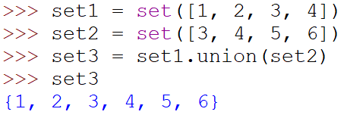
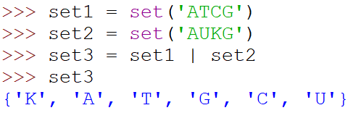
Finding the Union of Sets
Union of two sets: a set that contains all the elements of both sets
To find the union of two sets:
Use the union method
Format: set1.union(set2)
Or, use the | operator
Format: set1 | set2
Notes:
Both techniques return a new set which contains the union of both sets

Slide 23
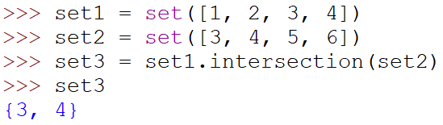
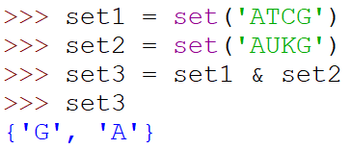
Finding the Intersection of Sets
Intersection of two sets: a set that contains only the elements found in both sets
To find the intersection of two sets:
Use the intersection method
Format: set1.intersection(set2)
Or, use the & operator
Format: set1 & set2
Notes:
Both techniques return a new set which contains the intersection of both sets

Slide 24
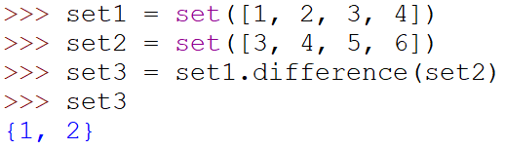
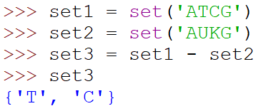
Finding the Difference of Sets
Difference of two sets: a set that contains the elements that appear in the first set but do not appear in the second set
To find the difference of two sets:
Use the difference method
Format: set1.difference(set2)
Or, use the - operator
Format: set1 - set2

Slide 25
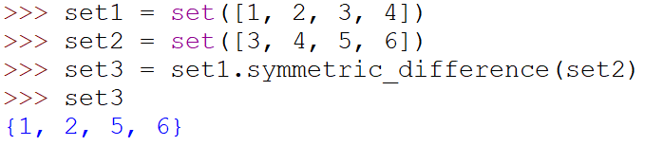
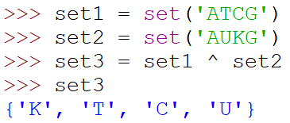
Finding the Symmetric Difference of Sets
Symmetric difference of two sets: a set that contains the elements that are not shared by the two sets
To find the symmetric difference of two sets:
Use the symmetric_difference method
Format: set1.symmetric_difference(set2)
Or, use the ^ operator
Format: set1 ^ set2

Slide 26
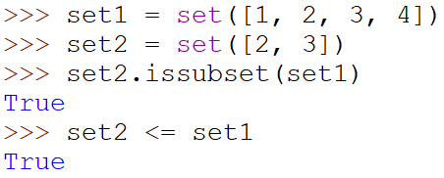
Finding Subsets and Supersets
Set A is subset of set B if all the elements in set A are included in set B
To determine whether set A is subset of set B
Use the issubset method
Format: setA.issubset(setB)
Or, use the <= operator
Format: setA <= setB

Slide 27
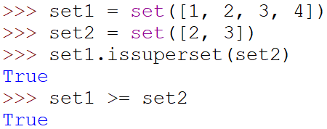
Finding Subsets and Supersets (cont’d.)
Set A is superset of set B if it contains all the elements of set B
To determine whether set A is superset of set B
Use the issuperset method
Format: setA.issuperset(setB)
Use the >= operator
Format: setA >= setB

Slide 28
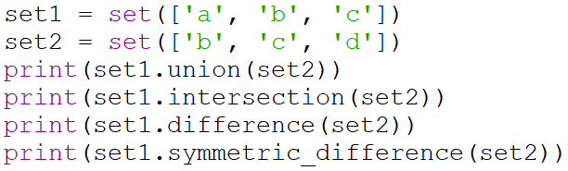
Knowledge Check
1. After the following statements execute, what elements will be stored in myset1 and myset2?
2. What is the output?
Notes:
myset1 will have the elements: {'w', 'z', 'y', ' ', 'x’}
myset2 will have the elements: {'zzz', 'xxx', 'yyy', 'www’}
2. {'c', 'b', 'd', 'a’}
{'b', 'c’}
{'a’}
{'d', 'a'}

Slide 29
Serializing Objects
Serialize an object: convert the object to a stream of bytes that can easily be stored in a file
Pickling: serializing an object
Notes:
Sometimes you need to store the contents of a complex object, such as a dictionary or a set, to a file. The easiest way to save an object to a file is to serialize the object. When an object is serialized, it is converted to a stream of bytes that can be easily stored in a file for later retrieval. In Python, the process of serializing an object is referred to as pickling. The Python standard library provides a module named pickle that has various functions for serializing, or pickling, objects.

Slide 30
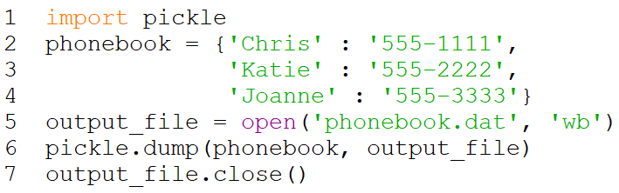
Serializing Objects (cont’d.)
To pickle an object:
Import the pickle module
Open a file for binary writing (‘wb’ mode)
Call the pickle.dump function
Format: pickle.dump(object, file)
Close the file
You can pickle multiple objects to one file prior to closing the file

Slide 31
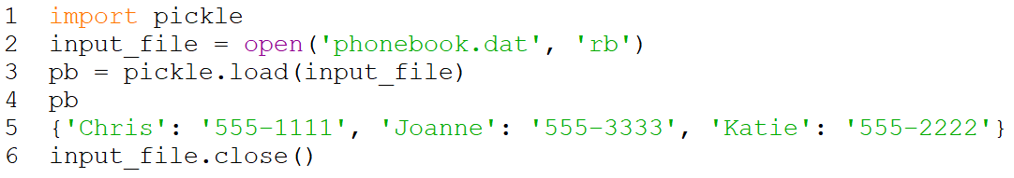
Serializing Objects (cont’d.)
Unpickling: retrieving pickled object
To unpickle an object:
Import the pickle module
Open a file for binary reading (‘rb’ mode)
Call the pickle.load function
Format: pickle.load(file)
Close the file
You can unpickle multiple objects from the file

Slide 32
Summary
This chapter covered:
Dictionaries, including:
Creating dictionaries
Inserting, retrieving, adding, and deleting key-value pairs
for loops and in and not in operators
Dictionary methods

Slide 33
Summary (cont’d.)
This chapter covered (cont’d):
Sets:
Creating sets
Adding elements to and removing elements from sets
Finding set union, intersection, difference and symmetric difference
Finding subsets and supersets
Serializing objects
Pickling and unpickling objects

